Slide 1
AMAZON SALES
DATA ANALYSIS REPORT
Ankita Gupta, Sanjeev Kumar

Slide 2
Problem Statement
Objective
Benefits
Help out to make better business decisions.
Help analyze customer trends and satisfaction, which can lead to new and better products and services.
Gives better insight of customers base.
Helps in easy flow for managing resources.
Sales management has gained importance to meet increasing competition and the need
for improved methods of distribution to reduce cost and to increase profits. Sales
management today is the most important function in a commercial and business
enterprise.
Develop a Report by Extracting-Transforming-Loading of data which contains Sales trend with respect to Year, Month, Quarter and find Some relationships through data to understand and Analyze the Facts.

Slide 3
Quick Insight
﻿A quick insight for 2010 | 2011 | 2012 | 2013 | 2014 | 2015 | 2016 | 2017 | amazon sales.
100
Total Order
512.87K
Total Quantity
44.17M
Total Profit
137.35M
Total Revenue
0.05
Avg Delivery Day

Slide 4
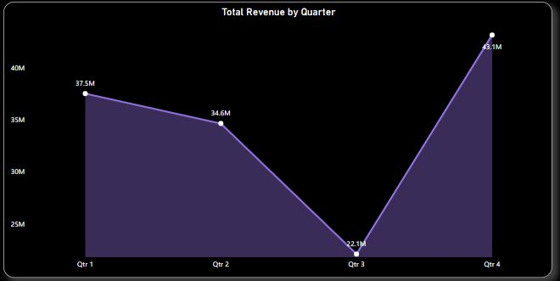
Total Revenue for all the quarters
﻿in Quarter 1 we have achieved the maximum Revenue i.e 37.5M

Slide 5
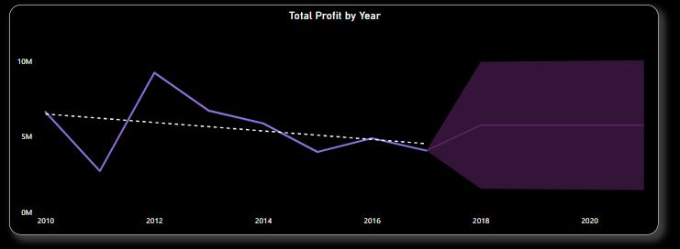
Yearly Sales Comparison
The sales in 2012 is high when compared and we can observe for the sales after 2012 is dropped.

Slide 6
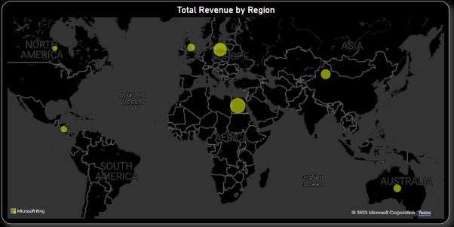
Revenue Categorized By Region
﻿We have achieved the highest revenue in the Africa region i.e 39M

Slide 7
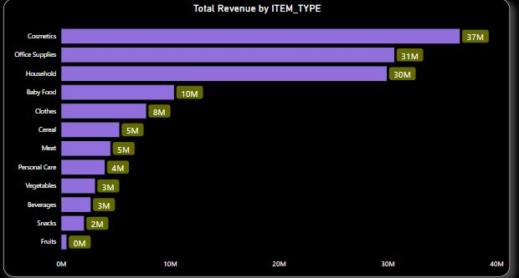
Top 10 item-type w.r.t revenue
Cosmetics have achieved the maximum revenue among all i.e 37M

Slide 8
Conclusion
In the year 2012 stands out as a record-breaking period, with our highest revenue attainment i,e 32 Million
2. In 2012, we not only achieved our highest total quantity sold but also recorded the highest total number of orders, showcasing a remarkable performance during that year.
3. Cosmetic products have recorded the highest quantity sold, demonstrating strong demand in this category.
4. In 2012, we achieved our highest level of profit, signifying a significant achievement in our overall performance.
5. Online sales channel has the highest profit earned amongst all

